Slide 1


Kexin Jiao
04/17/2024

Slide 2

Outline
Executive Summary
Introduction
Methodology
Results
Conclusion
Appendix

Slide 3
Executive Summary
Summary of methodologies
Data collection through API
Data collection with web scraping
Data wrangling
Exploratory data analysis with SQL
Exploratory data analysis with data visualization
Interactive visual analytics with folium
Machine learning prediction
Summary of all results
Exploratory data analysis result
Interactive analytics in screenshots
Predictive analytics result

Slide 4
Introduction
Project background and context
SpaceX advertises Falcon 9 rocket launches on its website with a cost of 62 million dollars; other providers cost upwards of 165 million dollars each, much of the savings is because SpaceX can reuse the first stage. Therefore, if we can determine if the first stage will land, we can determine the cost of a launch. Spaces X’s Falcon 9 launch like regular rockets. we will determine if the first stage will land, and determine the cost of a launch. We will train a machine learning model and use public information to predict if SpaceX will reuse the first stage.
Problems you want to find answers
The factors that determine if the rocket will land successfully
How do those factors interact to affect the success rate of landing
Build a mode for predicting the success rate of landing based on the major factors

Slide 5

Section 1

Slide 6
Methodology
Executive Summary
Data collection methodology:
Describe how data was collected
Perform data wrangling
Describe how data was processed
Perform exploratory data analysis (EDA) using visualization and SQL
Perform interactive visual analytics using Folium and Plotly Dash
Perform predictive analysis using classification models
How to build, tune, evaluate classification models

Slide 7
Data Collection
Data collection methods.
Use get request from the SpaceX API
Data was also collected using web scraping from website
Decode the requested content as a Json file followed by turning it into a pandas dataframe
The data collected from website was extracted as HTML tables followed by converting the tables to pandas dataframes
Clean data, fill the missing values with the average value

Slide 8
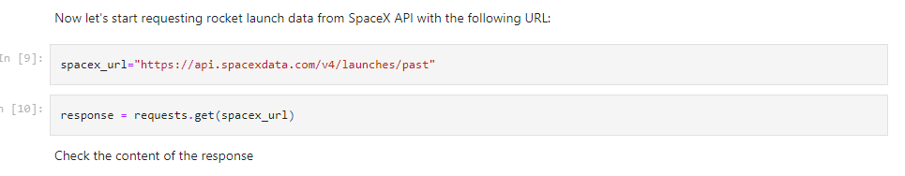
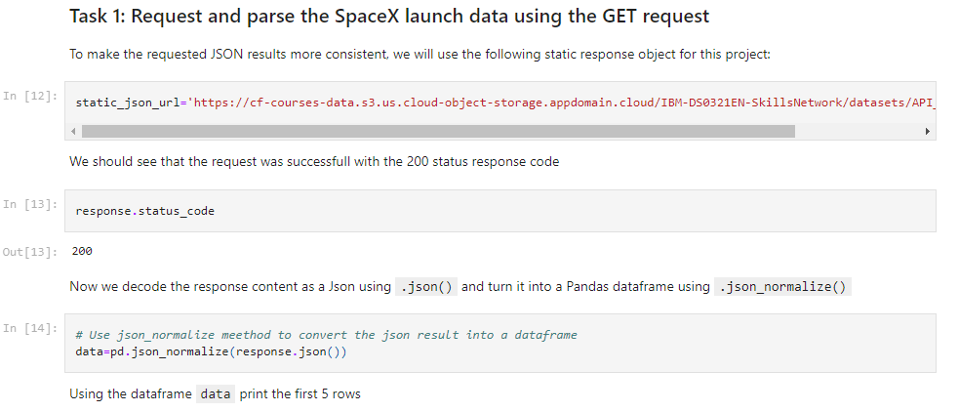
Data Collection – SpaceX API
We used get request from the SpaceX API. The collected data was cleaned and reformatted .
https://github.com/Kexin-Jiao/IBM-Applied-Data-Science-Capstone/blob/main/jupyter-labs-spacex-data-collection-api.ipynb

Slide 9
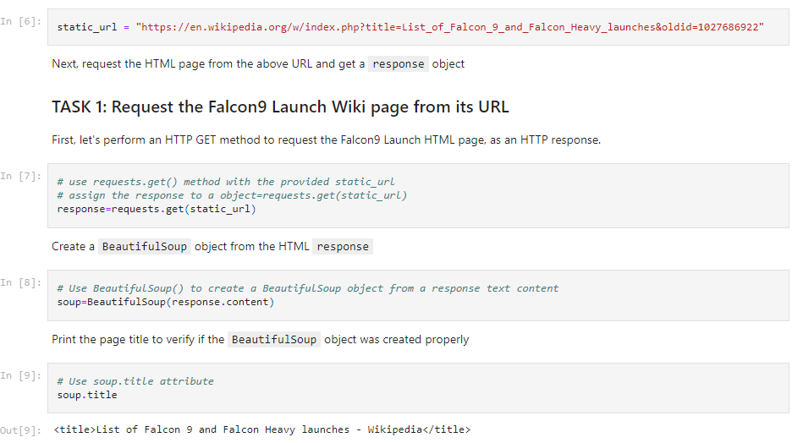
Data Collection - Scraping
Web scraping using BeautifulSoup
The table was parsed and converted into pandas dataframe
https://github.com/Kexin-Jiao/IBM-Applied-Data-Science-Capstone/blob/main/jupyter-labs-webscraping.ipynb

Slide 10
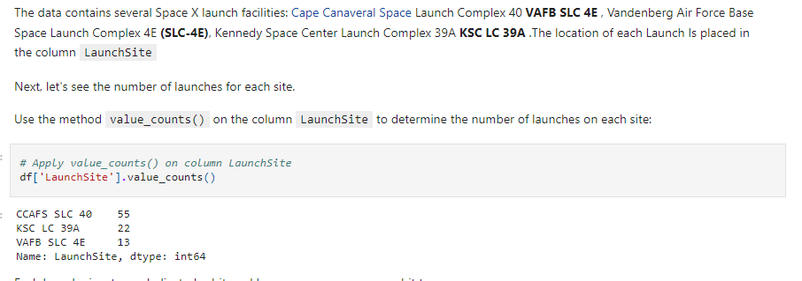
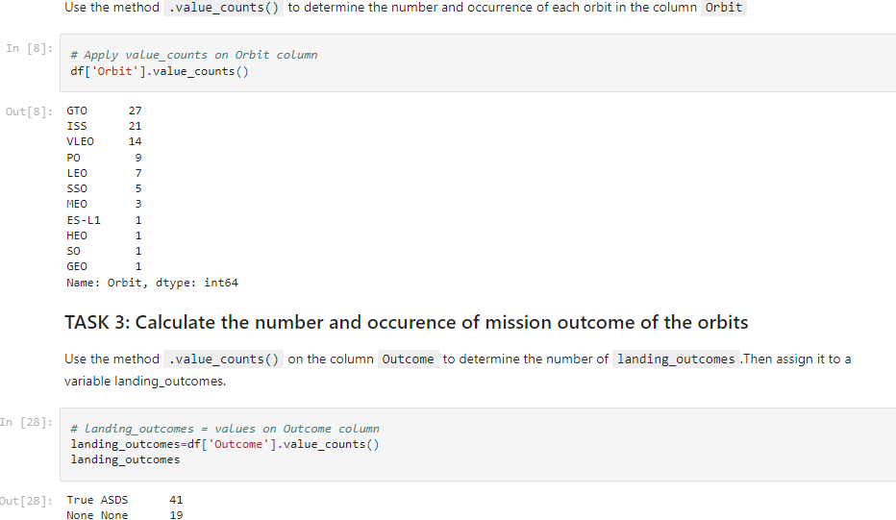
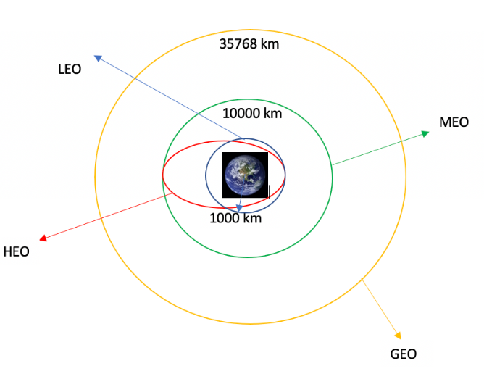
Data Wrangling
The training labels were determined by performing exploratory data analysis
The number of each orbits and launches at each site were calculated
https://github.com/Kexin-Jiao/IBM-Applied-Data-Science-Capstone/blob/main/labs-jupyter-spacex-Data%20wrangling.ipynb

Slide 11
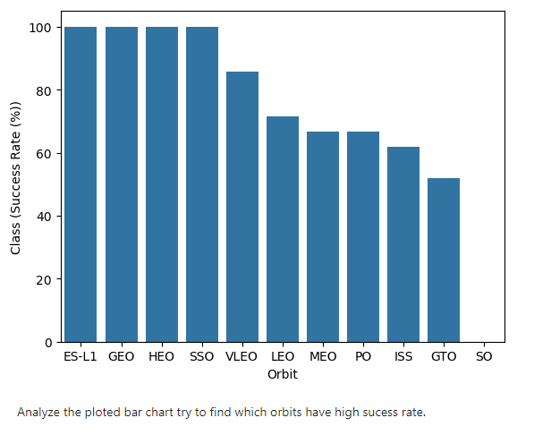
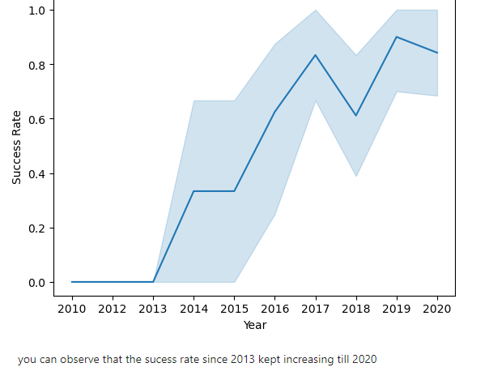
EDA with Data Visualization
The data was explored using the visualization of the relationship between flight number and launch site, the payload and launch site, the flight number and orbit type, and the launch success trend.
https://github.com/Kexin-Jiao/IBM-Applied-Data-Science-Capstone/blob/main/edadataviz.ipynb

Slide 12
EDA with SQL
The SpaceX dataset was loaded into a SQL database in the jupyter notebook. The data was read and explored by applying EDA with SQI.
Several queries were performed and shown in the figure
https://github.com/Kexin-Jiao/IBM-Applied-Data-Science-Capstone/blob/main/jupyter-labs-eda-sql-coursera_sqllite.ipynb

Slide 13
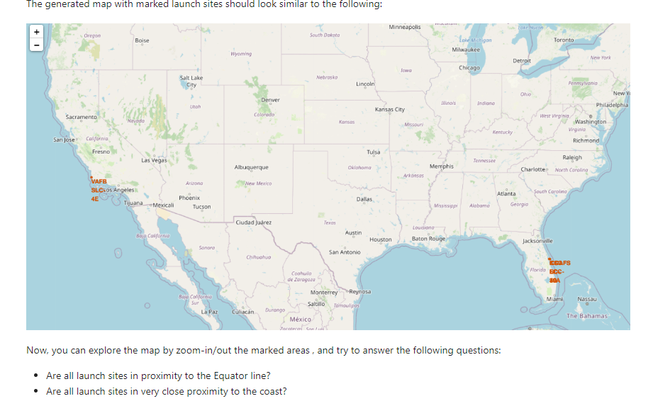
Build an Interactive Map with Folium
All the launch sites were marked with additional map objects to label the success or failure of launches for each site.
We used the color-labled marker clusters to identify the launch sites having high success rate.
We calculated the distance between a launch site to the proximities
Add the GitHub URL of your completed interactive map with Folium map, as an external reference and peer-review purpose
https://github.com/Kexin-Jiao/IBM-Applied-Data-Science-Capstone/blob/main/lab_jupyter_launch_site_location.ipynb

Slide 14
Build a Dashboard with Plotly Dash
Summarize what plots/graphs and interactions you have added to a dashboard
Explain why you added those plots and interactions
Add the GitHub URL of your completed Plotly Dash lab, as an external reference and peer-review purpose

Slide 15
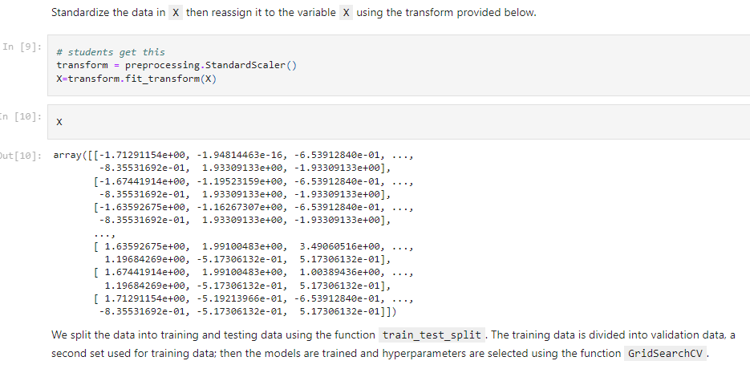
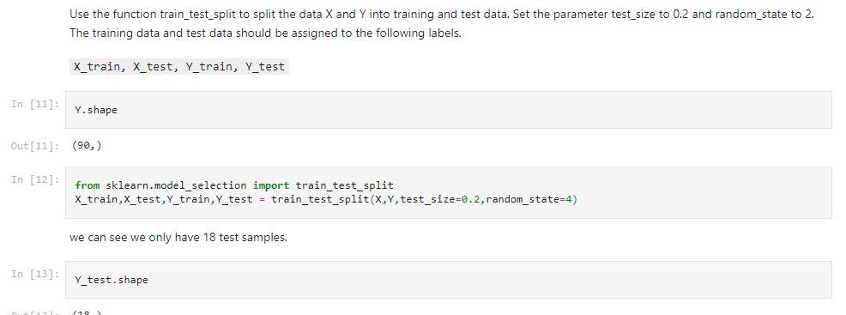
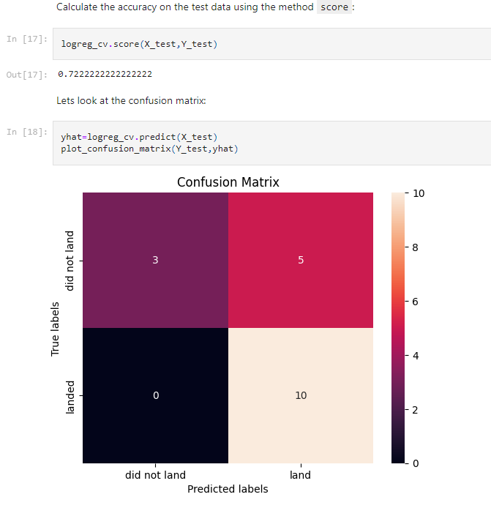
Predictive Analysis (Classification)
We used pandas and numpy to transform and assign training and testing data groups
Multiple machine learning models were built and tuned with different hyper parameters using GridSearchCV
The machine learning models were evaluated using accuracy followed by being optimized using feature engineering and algorithm tuning.
https://github.com/Kexin-Jiao/IBM-Applied-Data-Science-Capstone/blob/main/SpaceX_Machine%20Learning%20Prediction_Part_5.ipynb

Slide 16
Results
Exploratory data analysis results
Interactive analytics demo in screenshots
Predictive analysis results

Slide 17

Section 2

Slide 18
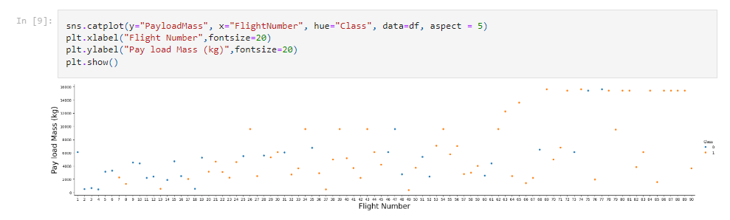
Flight Number vs. Launch Site
Conclusion: the larger the flight amount at a launch site, the greater the success rate at a launch site.

Slide 19
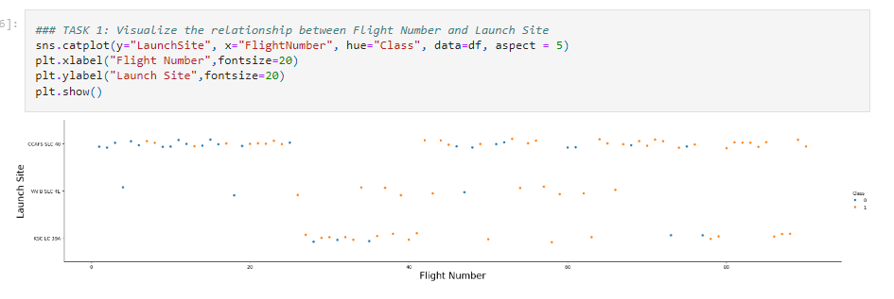
Payload vs. Launch Site
We found that the greater the payload mass for launch site CCAFS SLC 40 the higher the success rate for the rocket

Slide 20
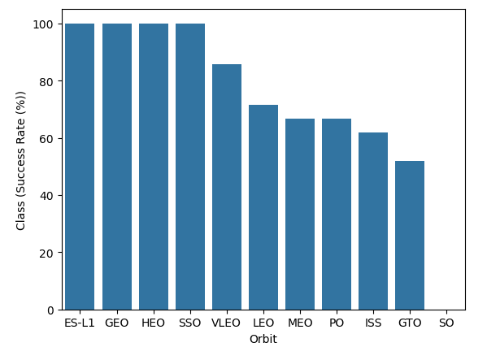
Success Rate vs. Orbit Type
The figure shows that ES-L1, GEO, HEO, SSO, and VLEO had the most success rate.

Slide 21
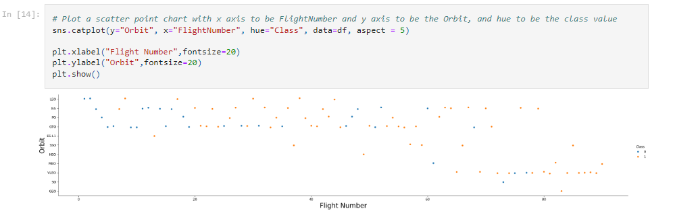
Flight Number vs. Orbit Type
This plot shows the change at Orbit type as a function of Flight Number. It shows that the LEO orbit, success is related to the number of flights. However, the GTO orbit has no significant relationship with the flight number.

Slide 22
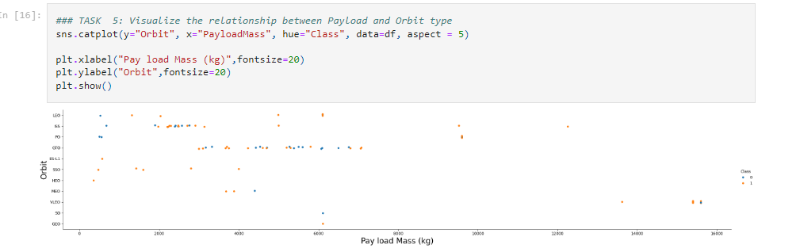
Payload vs. Orbit Type
It is observed that the PO, LEO, and ISS orbits have higher successful landing rate with heavy payloads.

Slide 23
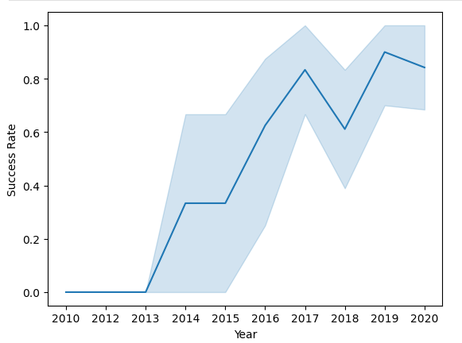
Launch Success Yearly Trend
It is observed from the plot that the success rate increased since 2013 till 2020

Slide 24
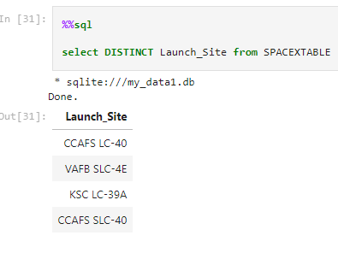
All Launch Site Names
The unique launch sites from the SpaceX data were shown using the key word DISTINCT

Slide 25
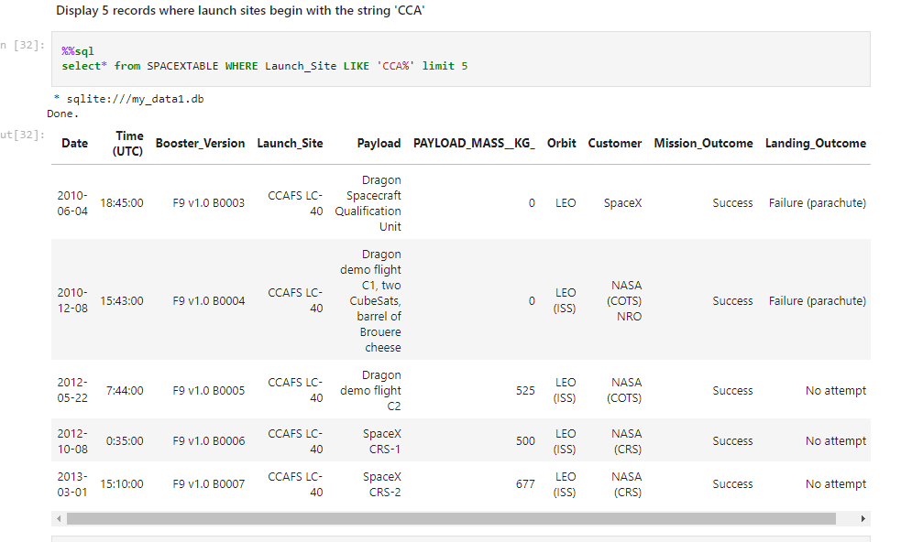
Launch Site Names Begin with 'CCA'
Five record where launch sites begin with “CCA” were displayed

Slide 26
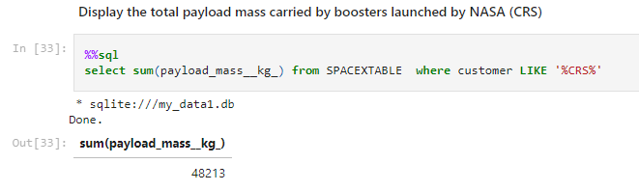
Total Payload Mass
The total payload carried y boosters from NASA as 48213 was calculated using the query below

Slide 27
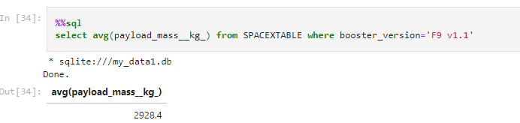
Average Payload Mass by F9 v1.1
The average payload mass carried by the booster version F9 v1.1 is 2928.4 kg

Slide 28
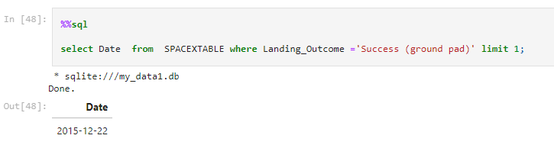
First Successful Ground Landing Date
The first successful landing outcome on ground pas happened on December 22nd 2015.

Slide 29
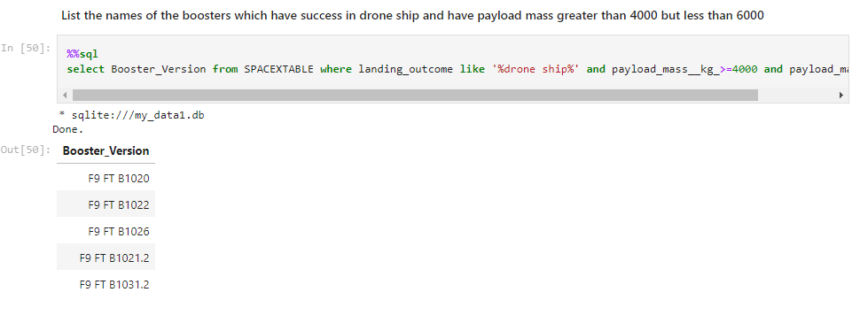
Successful Drone Ship Landing with Payload between 4000 and 6000
We list the names of boosters which have successfully landed on drone ship and had payload mass greater than 4000 but less than 6000 using WHERE clause with AND condition

Slide 30
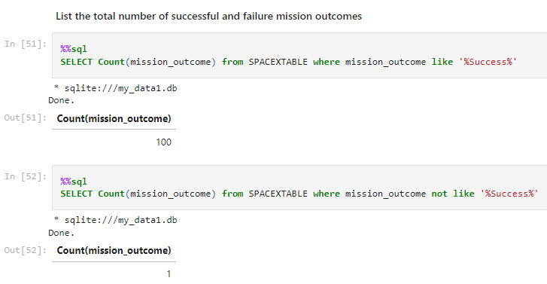
Total Number of Successful and Failure Mission Outcomes
We used WHERE and “%” to filter the desired values

Slide 31
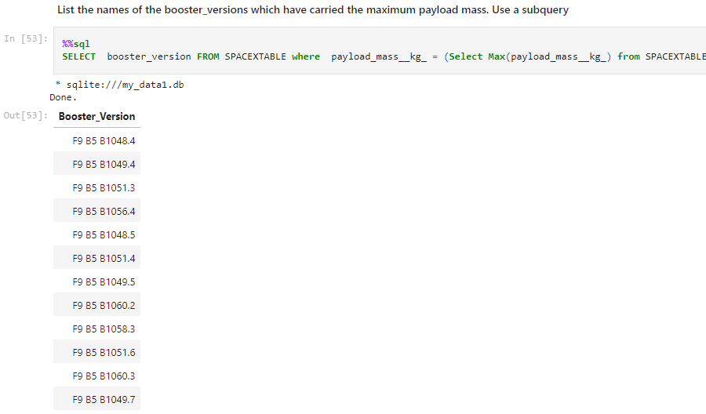
Boosters Carried Maximum Payload
The booster that carried the maximum payload was determined using the subquery clause and the MAX() function

Slide 32
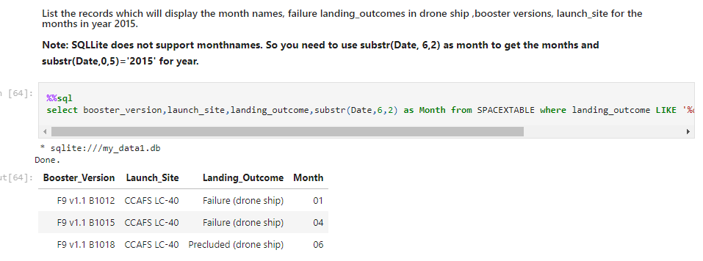
2015 Launch Records
We used WHERE clause with LIKE, AND, and BETWEEN conditions to filter out the failed landing outcomes in drone ship, the booster versions, and the launch site names in 2015

Slide 33
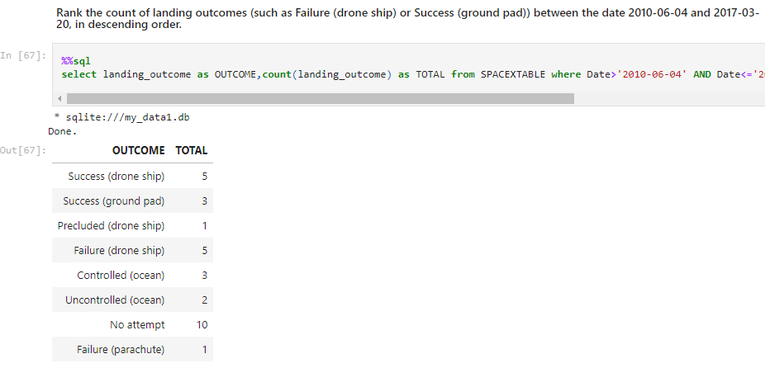
Rank Landing Outcomes Between 2010-06-04 and 2017-03-20
We used COUNT, BETWEEN condition in WHERE clause to filter out the landing outcomes between 2010/06/04 to 2010/03/20
WE applied GROUP BY and ORDER BY clauses to group then order the landing outcome in a descending order.

Slide 34

Section 3

Slide 35
<Folium Map Screenshot 1>
The SpaceX launch sites are in Florida and California in United States.

Slide 36
<Folium Map Screenshot 2>
Replace <Folium map screenshot 2> title with an appropriate title
Explore the folium map and make a proper screenshot to show the color-labeled launch outcomes on the map
Explain the important elements and findings on the screenshot

Slide 37
<Folium Map Screenshot 3>
Replace <Folium map screenshot 3> title with an appropriate title
Explore the generated folium map and show the screenshot of a selected launch site to its proximities such as railway, highway, coastline, with distance calculated and displayed
Explain the important elements and findings on the screenshot

Slide 38

Section 4

Slide 39
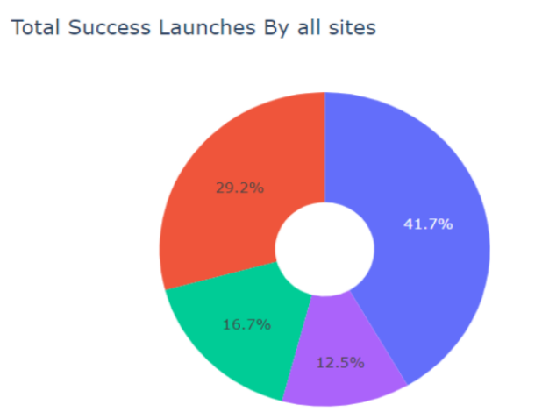
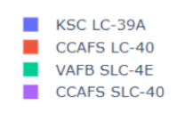
<Dashboard Screenshot 1>
KSC LC-39A had the most successful launches from all the sites

Slide 40
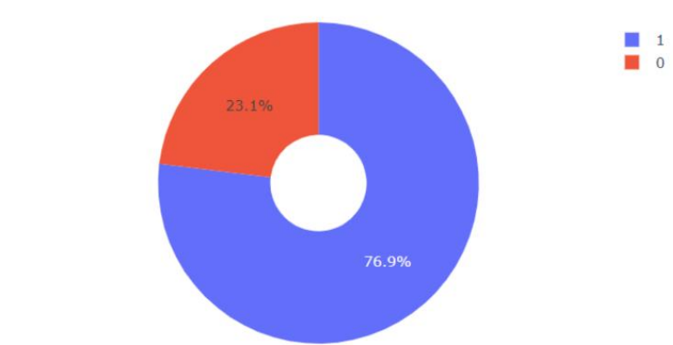
<Dashboard Screenshot 2>
KSC LC-39A achieved a 76.9% success rate while getting a 23.1% failure rate

Slide 41
<Dashboard Screenshot 3>
Replace <Dashboard screenshot 3> title with an appropriate title
Show screenshots of Payload vs. Launch Outcome scatter plot for all sites, with different payload selected in the range slider
Explain the important elements and findings on the screenshot, such as which payload range or booster version have the largest success rate, etc.

Slide 42

Section 5

Slide 43
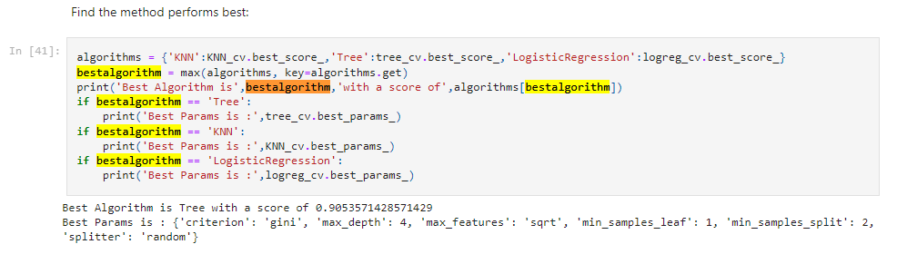
Classification Accuracy
The decision tree classifier model has the highest classification accuracy

Slide 44
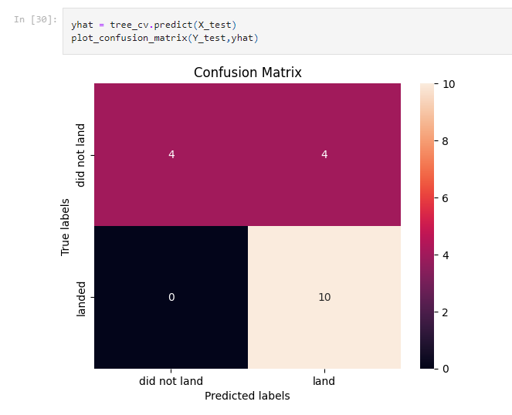
Confusion Matrix
The confusion matrix shows that the model has good accuracy for those successful landings but low accuracy for not successful landings. That means the major issue is the false positives.

Slide 45
Conclusions
The success rate at a launch site increases as the flight amount at the launch site increases
The launch success rate increased since 2013 to 2020
KSC LC-39A has the highest number of successful launches for any launch sites
The decision tree classifier is the best machine learning model for this task

Slide 46
Appendix
Include any relevant assets like Python code snippets, SQL queries, charts, Notebook outputs, or data sets that you may have created during this project

Slide 47


